Slide 1
Data Warehousing and Data Mining

Slide 2
UNIT I

Slide 3
Topics to be covered
Basic Concepts
Data Ware House Modeling: Cube and OLAP
Data Ware House Design and Usage
Data Ware House Implementation

Slide 4
Basic Concepts

Slide 5
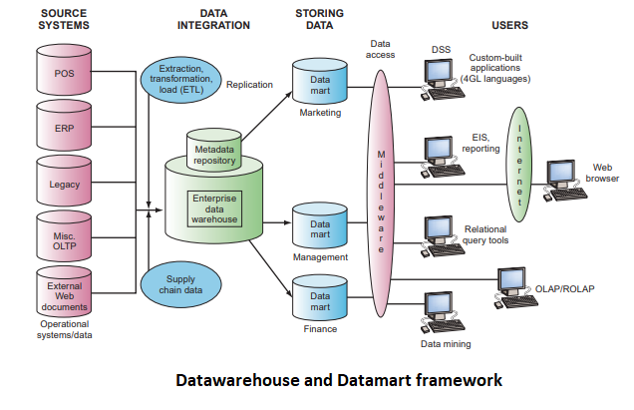

Slide 7
What is Data Warehouse??????
It is an emerging data repository architecture.
This is a repository of multiple heterogeneous data sources organized under a unified schema at a single site to facilitate management decision making.
“A data warehouse is a subject - oriented, integrated, time variant and non-volatile collection of data in support of management decision making process.”
These four keywords—subject-oriented, integrated, time-variant, and nonvolatile distinguish data warehouses from other data repository systems, such as relational database systems, transaction processing systems, and file systems.

Slide 8
Data Warehouse Properties
Subject
Oriented
Integrated
Data
Warehouse
Non Volatile
Time Variant

Slide 9
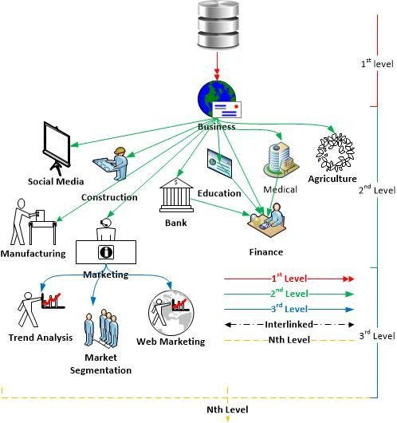
Levels of Data Warehouse

Slide 10
Subject-Oriented : Stored data according to target specific subjects.
Example : It may store data regarding total Sales, Number of Customers, etc. and not general data on everyday operations.
Integrated : Data may be distributed across heterogeneous sources which have to be integrated.
Example: Sales data may be on RDB, Customer information on Flat files, etc.
Time Variant : Data are stored to provide information from an historic perspective. Example: Data of sales in last 5 years, etc.
Non-Volatile : It is separate from the Enterprise Operational Database and hence is not subject to frequent modification. It generally has only 2 operations performed on it: Loading of data and Access of data.

Slide 11

Heterogeneous Information Sources
“Heterogeneities are everywhere”
Personal
Databases
World
Wide
Web
Scientific Databases
Digital Libraries
Different interfaces
Different data representations
Duplicate and inconsistent information

Slide 12
Features of a Warehouse…….
It is separate from Operational Database.
Integrates data from heterogeneous systems.
Stores HUGE amount of data, more historical than current data.
Does not require data to be highly accurate.
Queries are generally complex.
Goal is to execute statistical queries and provide results which can influence decision making in favor of the Enterprise.
These systems are thus called Online Analytical Processing Systems (OLAP).

Slide 13
Difference
Database is a collection of related data that represents some elements of the real world whereas Data warehouse is an information system that stores historical and commutative data from single or multiple sources.
Database is designed to record data whereas the Data warehouse is designed to analyze data.
Database is application-oriented-collection of data whereas Data Warehouse is the subject-oriented collection of data.
Database uses Online Transactional Processing (OLTP) whereas Data warehouse uses Online Analytical Processing (OLAP).
Database tables and joins are complicated because they are normalized whereas Data Warehouse tables and joins are easy because they are denormalized.
ER modeling techniques are used for designing Database whereas data modeling techniques are used for designing Data Warehouse.

Slide 14
Need of a Separate Data Warehouse
OLTP systems require high Concurrency, Reliability, Locking which provide good performance for short and simple OLTP queries. An OLAP query is very complex and does not require these properties. Use of OLAP query on OLTP system degrades its performance.
OLAP systems access historical data and not current volatile data while OLTP systems access current up-to-date data and do not need historical data.
An operational database is designed for known tasks like indexing and hashing using primary keys, searching for particular records, and many more.
On the other hand, data warehouse queries are often complex. They involve the computation of large data groups at summarized levels, and may require the use of special data organization, access, and implementation methods based on multidimensional views.

Slide 15
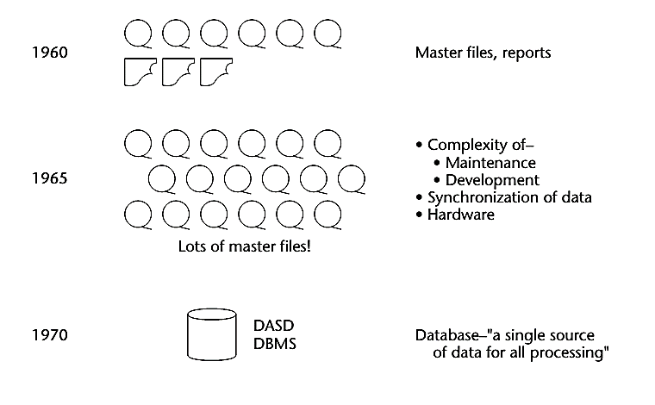
Origin/Evolution of Data Warehouse

Slide 16
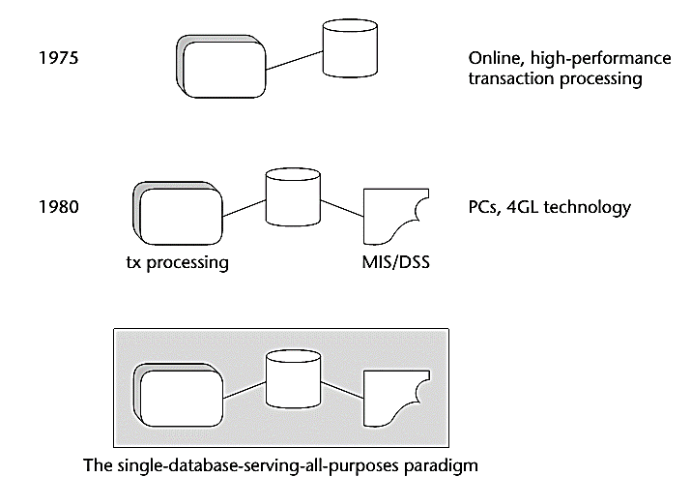

Slide 17
In the early 1960s, the world of computation consisted of creating individual applications that were run using master files, usually built in an early language such as Fortran or COBOL. The master files were housed on magnetic tape. The magnetic tapes were good for storing a large volume of data cheaply, but the drawback was that they had to be accessed sequentially.
Around the mid-1960s, the growth of master files and magnetic tape exploded. And with that growth came huge amounts of redundant data.

Slide 18
By 1970, the day of a new technology for the storage and access of data had dawned. The 1970s saw the advent of disk storage, or the direct access storage device (DASD). Disk storage was fundamentally different from magnetic tape storage in that data could be accessed directly on a DASD. There was no need to go through records 1, 2, 3, . . . N to get to record N + 1.
By the mid-1970s, online transaction processing (OLTP) made even faster access to data possible. The computer could now be used for tasks not previously possible, including driving reservations systems, bank teller systems, manufacturing control systems, and the like.
By the 1980s, more new technologies, such as PCs and fourth-generation languages (4GLs), began to surface.

Slide 19
Key developments in early years of data warehousing:
1960s – General Mills and Dartmouth College, in a joint research project, develop the terms dimensions and facts.^{[11]}
1970s – ACNielsen and IRI provide dimensional data marts for retail sales.^{[11]}
1970s – Bill Inmon begins to define and discuss the term Data Warehouse.^{[citation needed]}
1975 – Sperry Univac introduces MAPPER (MAintain, Prepare, and Produce Executive Reports), a database management and reporting system that includes the world's first 4GL. It is the first platform designed for building Information Centers (a forerunner of contemporary data warehouse technology).
1983 – Teradata introduces the DBC/1012 database computer specifically designed for decision support.^{[12]}
1984 – Metaphor Computer Systems, founded by David Liddle and Don Massaro, releases a hardware/software package and GUI for business users to create a database management and analytic system.

Slide 20
1985 - Sperry Corporation publishes an article (Martyn Jones and Philip Newman) on information centers, where they introduce the term MAPPER data warehouse in the context of information centers.
1988 – Barry Devlin and Paul Murphy publish the article "An architecture for a business and information system" where they introduce the term "business data warehouse".^{[13]}
1990 – Red Brick Systems, founded by Ralph Kimball, introduces Red Brick Warehouse, a database management system specifically for data warehousing.
1991 - James M. Kerr authors The IRM Imperative, which suggests data resources could be reported as an asset on a balance sheet, furthering commercial interest in the establishment of data warehouses.
1991 – Prism Solutions, founded by Bill Inmon, introduces Prism Warehouse Manager, software for developing a data warehouse.
1992 – Bill Inmon publishes the book Building the Data Warehouse.^{[14]}
1995 – The Data Warehousing Institute, a for-profit organization that promotes data warehousing, is founded.

Slide 21
1996 – Ralph Kimball publishes the book The Data Warehouse Toolkit.^{[15]}
2000 – Dan Linstedt releases in the public domain the Data vault modeling, conceived in 1990 as an alternative to Inmon and Kimball to provide long-term historical storage of data coming in from multiple operational systems, with emphasis on tracing, auditing and resilience to change of the source data model.
2008 – Bill Inmon, along with Derek Strauss and Genia Neushloss, publishes "DW 2.0: The Architecture for the Next Generation of Data Warehousing", explaining his top-down approach to data warehousing and coining the term, data-warehousing 2.0.
2012 – Bill Inmon develops and makes public technology known as "textual disambiguation". Textual disambiguation applies context to raw text and reformats the raw text and context into a standard data base format. Once raw text is passed through textual disambiguation, it can easily and efficiently be accessed and analyzed by standard business intelligence technology. Textual disambiguation is accomplished through the execution of textual ETL. Textual disambiguation is useful wherever raw text is found, such as in documents, Hadoop, email, and so forth.

Slide 22
Differences between Operational Database Systems and Data Warehouses
The major task of operational database systems is to perform online transaction and query processing. These systems are called Online Transaction Processing (OLTP) systems. It covers most of the day-to-day operations of an organization such as purchasing, inventory, manufacturing, banking, payroll, registration, and accounting.
Data warehouse systems, on the other hand, serve users or knowledge workers in the role of data analysis and decision making. These systems are known as online analytical processing (OLAP) systems.

Slide 23
OLAP vs. OLTP: Which is best for you?
Choosing the right system for your situation depends on your objectives.
Do you need a single platform for business insights? OLAP can help you unlock value from vast amounts of data.
Do you need to manage daily transactions? OLTP is designed for fast processing of large numbers of transactions per second.

Slide 24
 | Operational DB Systems | Data Warehouse Systems
Users | An OLTP system is customer-oriented and used by clerks, clients, and IT professionals. | An OLAP system is market-oriented and is used for data analysis by knowledge workers, including managers, executives, and analysts.
Data Contents | Current and detailed data and is subject to modifications. | Historical data generally not modified.
Database Design | Usually E-R model. (Application oriented Database Design) | Usually Multidimensional model (Star, Snowflake…). (Subject Oriented Database Design)
Access Pattern (Nature of Query) | OLTP systems mainly consist for Short and atomic transaction desiring high performance (less latency) and accuracy. It requires Concurrence Control and Recovery mechanisms. | Mostly read only queries, operate on HUGE volumes of data, queries are quite complex.
Database Size | In Gigabytes to higher order Gigabytes. | > = Terabytes or Petabytes.
View | Detailed | Summarized.

Slide 25
Parameter | Database | Data Warehouse
Purpose | Is designed to record | Is designed to analyze
Processing Method | The database uses the Online Transactional Processing (OLTP) | Data warehouse uses Online Analytical Processing (OLAP).
Usage | The database helps to perform fundamental operations for your business | Data warehouse allows you to analyze your business.
Tables and Joins | Tables and joins of a database are complex as they are normalized. | Table and joins are simple in a data warehouse because they are denormalized.
Orientation | Is an application-oriented collection of data | It is a subject-oriented collection of data
Storage limit | Generally limited to a single application | Stores data from any number of applications
Availability | Data is available real-time | Data is refreshed from source systems as and when needed
Usage | ER modeling techniques are used for designing. | Data modeling techniques are used for designing.
Technique | Capture data | Analyze data
Data Type | Data stored in the Database is up to date. | Current and Historical Data is stored in Data Warehouse. May not be up to date.
Storage of data | Flat Relational Approach method is used for data storage. | Data Ware House uses dimensional and normalized approach for the data structure. Example: Star and snowflake schema.
Query Type | Simple transaction queries are used. | Complex queries are used for analysis purpose.
Data Summary | Detailed Data is stored in a database. | It stores highly summarized data.

Slide 26
Applications of Database
Sector | Usage
Banking | Use in the banking sector for customer information, account-related activities, payments, deposits, loans, credit cards, etc.
Airlines | Use for reservations and schedule information.
Universities | To store student information, course registrations, colleges, and results.
Telecommunication | It helps to store call records, monthly bills, balance maintenance, etc.
Finance | Helps you to store information related stock, sales, and purchases of stocks and bonds.
Sales & Production | Use for storing customer, product and sales details.
Manufacturing | It is used for the data management of the supply chain and for tracking production of items, inventories status.
HR Management | Detail about employee’s salaries, deduction, generation of paychecks, etc.

Slide 27
Applications of Data Warehouses
Sector | Usage
Airline | It is used for airline system management operations like crew assignment, analyzes of route, frequent flyer program discount schemes for passenger, etc.
Banking | It is used in the banking sector to manage the resources available on the desk effectively.
Healthcare sector | Data warehouse used to strategize and predict outcomes, create patient’s treatment reports, etc. Advanced machine learning, big data enable datawarehouse systems can predict ailments.
Insurance sector | Data warehouses are widely used to analyze data patterns, customer trends, and to track market movements quickly.
Retain chain | It helps you to track items, identify the buying pattern of the customer, promotions and also used for determining pricing policy.
Telecommunication | In this sector, data warehouse used for product promotions, sales decisions and to make distribution decisions.

Slide 28
Advantages of Data Warehouse (DWH)
Data warehouse allows business users to quickly access critical data from some sources all in one place.
Data warehouse provides consistent information on various cross-functional activities. It is also supporting ad-hoc reporting and query.
Data Warehouse helps to integrate many sources of data to reduce stress on the production system.
Data warehouse helps to reduce total turnaround time for analysis and reporting.
Restructuring and Integration make it easier for the user to use for reporting and analysis.
Data warehouse allows users to access critical data from the number of sources in a single place. Therefore, it saves user’s time of retrieving data from multiple sources.
Data warehouse stores a large amount of historical data. This helps users to analyze different time periods and trends to make future predictions.

Slide 29
Disadvantages of Data Warehouse:
Not an ideal option for unstructured data.
Creation and Implementation of Data Warehouse is surely time confusing affair.
Data Warehouse can be outdated relatively quickly
Difficult to make changes in data types and ranges, data source schema, indexes, and queries.
The data warehouse may seem easy, but actually, it is too complex for the average users.
Despite best efforts at project management, data warehousing project scope will always increase.
Sometime warehouse users will develop different business rules.
Organizations need to spend lots of their resources for training and Implementation purpose.

Slide 30
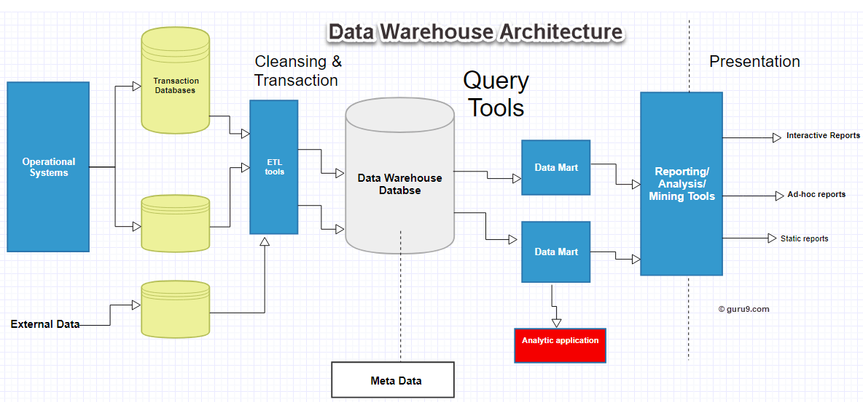

Slide 31
Data Warehouse Tools
There are many Data Warehousing tools are available in the market
1. MarkLogic:
MarkLogic is useful data warehousing solution that makes data integration easier and faster using an array of enterprise features. This tool helps to perform very complex search operations. It can query different types of data like documents, relationships, and metadata.
https://www.marklogic.com/product/getting-started/

Slide 32
2. Oracle:
Oracle is the industry-leading database. It offers a wide range of choice of data warehouse solutions for both on-premises and in the cloud. It helps to optimize customer experiences by increasing operational efficiency.
https://www.oracle.com/index.html

Slide 33
3. Amazon RedShift:
Amazon Redshift is Data warehouse tool. It is a simple and cost-effective tool to analyze all types of data using standard SQL and existing BI tools. It also allows running complex queries against petabytes of structured data, using the technique of query optimization.
https://aws.amazon.com/redshift/?nc2=h_m1
Many other tools are also available at https://www.guru99.com/top-20-etl-database-warehousing-tools.html

Slide 34
Data warehouse modeling: cube and OLAP

Slide 35
OLAP (Online Analytical Processing)

Slide 36
Online Analytical Processing
An OLAP system manages large amount of historical data, provides facilities for summarization and aggregation, and stores and manages information at different levels of granularity.

Slide 37
Why Separate Data Warehouse?
High performance for both systems
DBMS— tuned for OLTP: access methods, indexing, concurrency control, recovery
Warehouse—tuned for OLAP: complex OLAP queries, multidimensional view, consolidation.
Different functions and different data:
missing data: Decision support requires historical data which operational DBs do not typically maintain
data consolidation: DS requires consolidation (aggregation, summarization) of data from heterogeneous sources
data quality: different sources typically use inconsistent data representations, codes and formats which have to be reconciled

Slide 38
From Tables and Spreadsheets to Data Cubes
A data warehouse is based on a multidimensional data model which views data in the form of a data cube.
A data cube, such as sales, allows data to be modeled and viewed in multiple dimensions
In data warehousing literature, an n-D base cube is called a base cuboid. The top most 0-D cuboid, which holds the highest-level of summarization, is called the apex cuboid. The lattice of cuboids forms a data cube.

Slide 39
OLTP vs. OLAP

Slide 40
OLAP Server Architectures
Relational OLAP (ROLAP):
Use relational or extended-relational DBMS to store and manage warehouse data and OLAP middle ware to support missing pieces.
Include optimization of DBMS backend, implementation of aggregation navigation logic, and additional tools and services
greater scalability
Multidimensional OLAP (MOLAP):
Array-based multidimensional storage engine (sparse matrix techniques)
fast indexing to pre-computed summarized data
Hybrid OLAP (HOLAP):
User flexibility, e.g., low level: relational, high-level: array.
Specialized SQL servers:
specialized support for SQL queries over star.snowflake schemas

Slide 41
Multidimensional Data
Sales volume as a function of product, month, and region
Dimensions: Product, Location, Time
Hierarchical summarization paths
Region
Industry Region Year
Category Country Quarter
Product City Month Week
Office Day
Product
Month

Slide 43
Typical OLAP Operations
Roll up (drill-up): summarize data
by climbing up hierarchy or by dimension reduction
Drill down (roll down): reverse of roll-up
from higher level summary to lower level summary or detailed data, or introducing new dimensions
Slice and dice:
project and select
Pivot (rotate):
reorient the cube, visualization, 3D to series of 2D planes.
Other operations
drill through: through the bottom level of the cube to its back-end relational tables (using SQL)

Slide 44
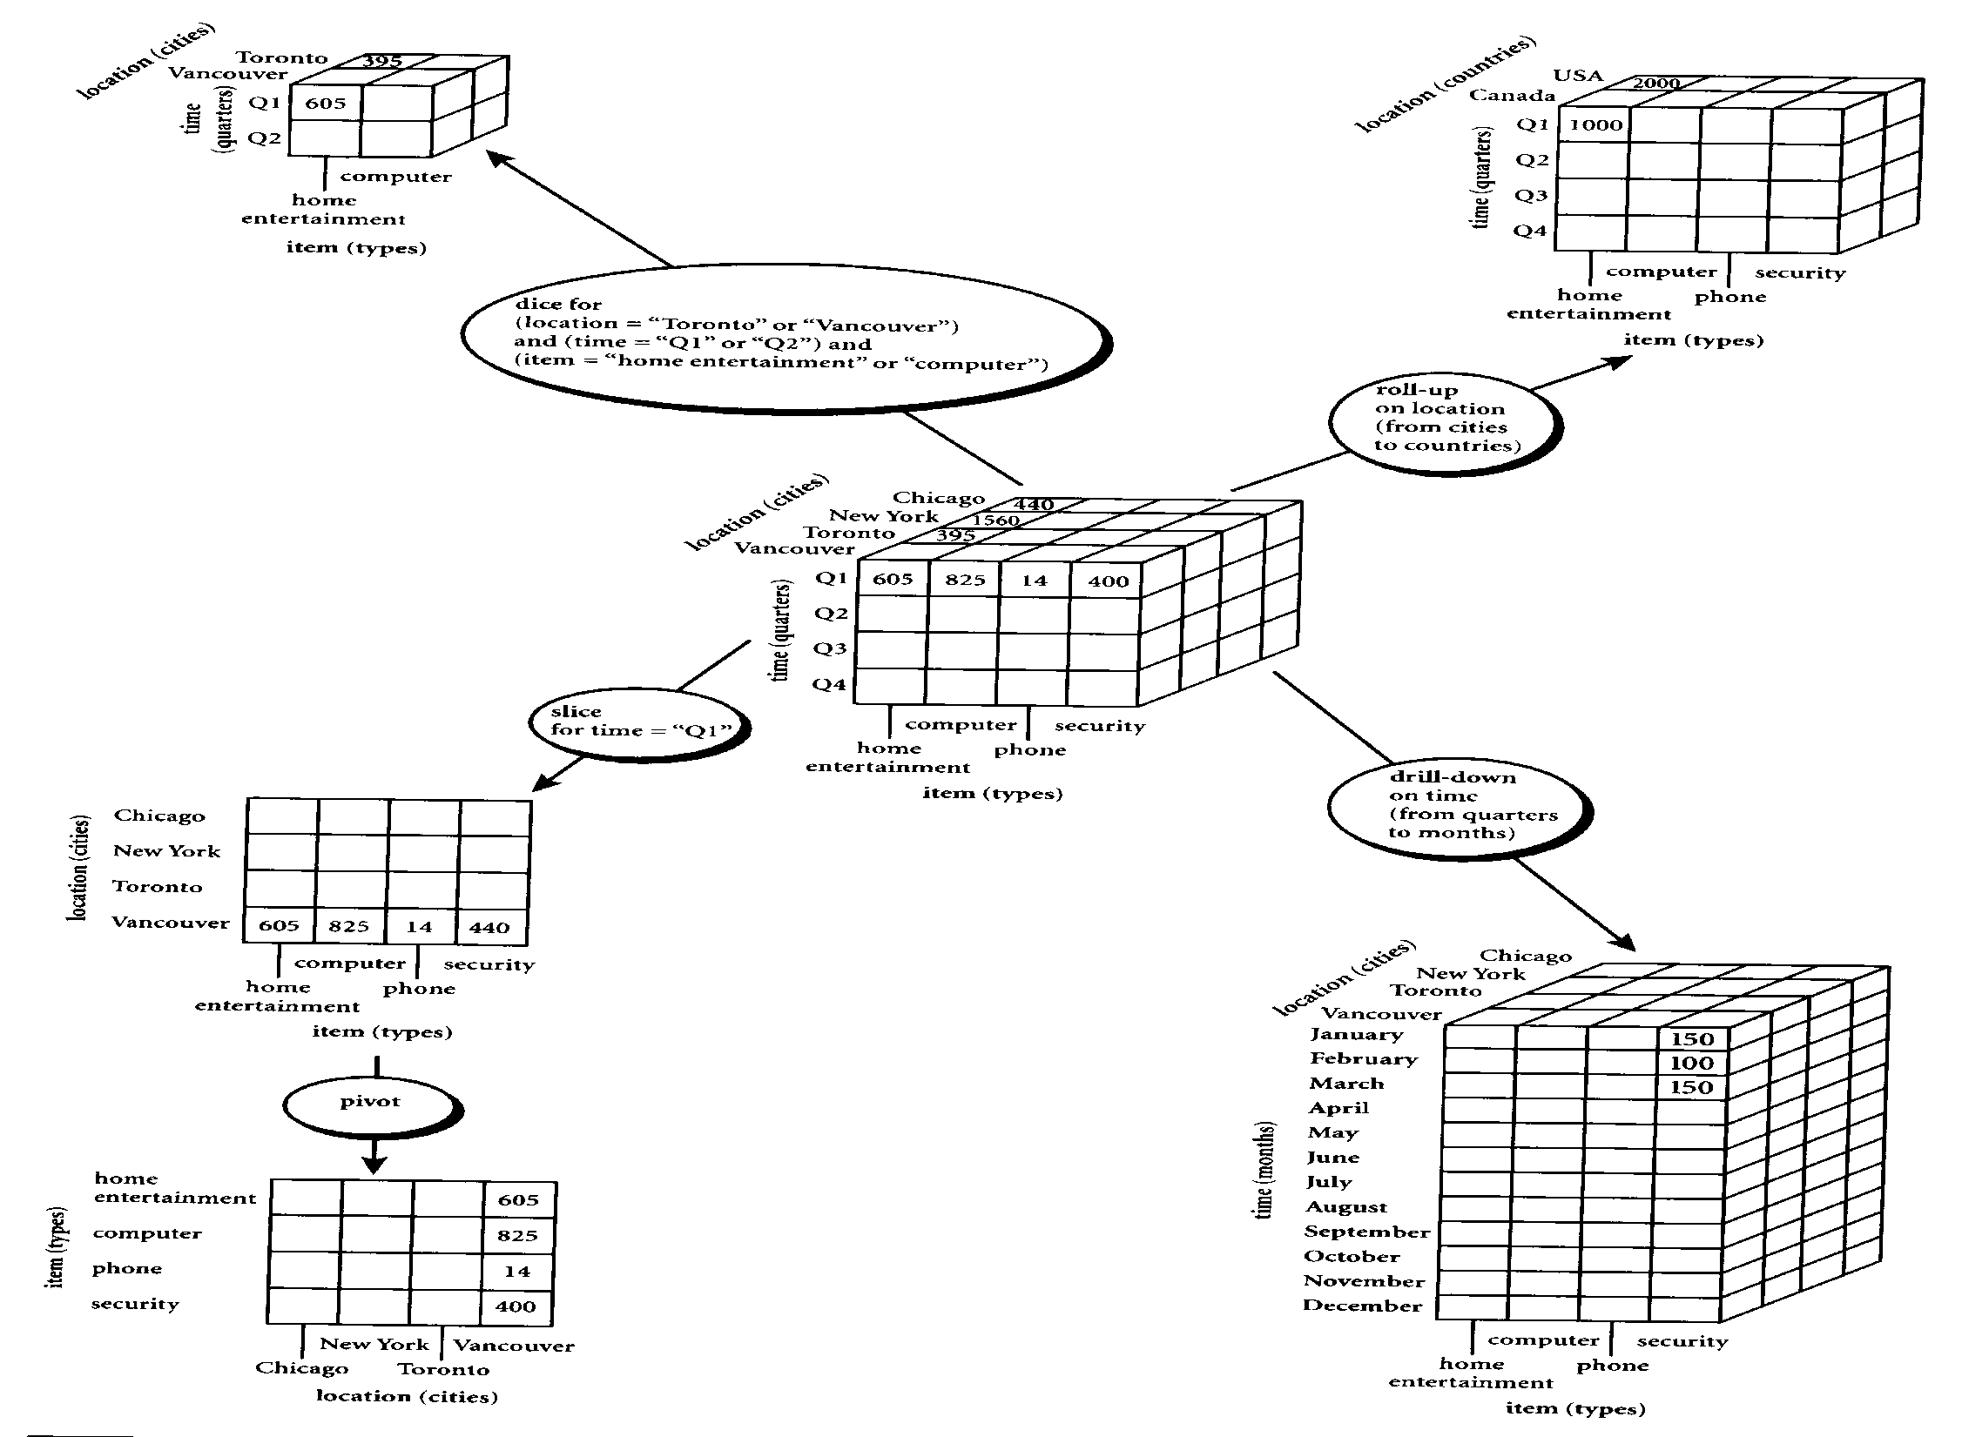

Slide 45
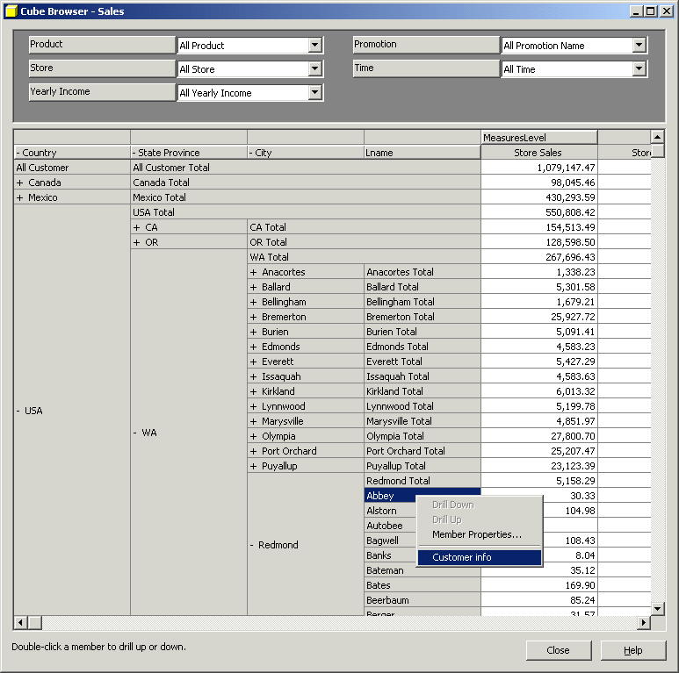
Sample OLAP Drill down online report

Slide 46
Cube Operation
Cube definition and computation in OLAP
define cube sales[item, city, year]: sum(sales_in_dollars)
compute cube sales
Transform it into a SQL-like language (with a new operator cube by)
SELECT item, city, year, SUM (amount)
FROM SALES
CUBE BY item, city, year
Need compute the following Group-Bys
(date, product, customer),
(date,product),(date, customer), (product, customer),
(date), (product), (customer)
()
()
(city)
(item)
(year)
(city, item)
(city, year)
(item, year)
(city, item, year)

Slide 47
Roll-up and Drill-down
The roll-up operation performs aggregation on a data cube, either by climbing up a concept hierarchy for a dimension or by dimension reduction such that one or more dimensions are removed from the given cube.
Drill-down is the reverse of roll-up. It navigates from less detailed data to more detailed data. Drill-down can be realized by either stepping down a concept hierarchy for a dimension or introducing additional dimensions.

Slide 48
Slice and dice
The slice operation performs a selection on one dimension of the given cube, resulting in a sub_cube.
The dice operation defines a sub_cube by performing a selection on two or more dimensions.

Slide 53
Querying with MDX (Multidimensional Expressions)
The select clause defines axis dimensions on COLUMNS and on ROWS, where clause supplies slicer dimensions, and Cube is the name of the data cube.
Select axis [, axis]
From Cube
Where slicer [, slicer]

Slide 54
The Data Hierarchy
For the majority of MDX statements, the context of the query will be limited to a single cube. It is important to know how all data within a cube is divided into the following relationship:
Dimensions
Hierarchies
Levels
Members

Slide 55
Sample MDX where italic are default
SELECT
{[Gender].[Gender].Members} ON COLUMNS,
{[Product].[Product Family].Members} ON ROWS,
FROM [Sales]
WHERE
([Measures].[Unit Sales],
[Customers].[All Customers],
[Education Level].[All Education Level],
[Marital Status].[All Martial status],
[Promotions].[All Promotions],
[Store].[All Stores],
[Store Size in SQFT].[All],
[Store Type].[All],
[Yearly Income].[All Yearly Income]

Slide 56
Example on Star Schema

Slide 57
Example on Roll-up
MDX
SELECT [SALES].[AMOUNT] ON COLUMNS,
[store].[Kowloon] ON ROWS
FROM SALES
SQL
select sum(amount), area
from SALES
where (area='Kowloon') group by area

Slide 58
Graphical Description on Roll-up Example
Roll-up
on Store Dimension
(from store to area)
Store is the child of Area

Slide 59
Example on Drill-down
MDX
SELECT [SALES].[AMOUNT] ON COLUMNS,
[time].[2003].[Q4].[Dec].[31],
[time].[2003].[Q4].[Dec].[30],… …,
[time].[2003].[Q4].[Dec].[2],
[time].[2003].[Q4].[Dec].[1] ON ROWS FROM SALES
SQL
select sum(amount), the_date
from SALES
where (the_date='2003-Dec-31')
or (the_date='2003-Dec-30')
or… …or (the_date='2003-Dec-2')
or (the_date='2003-Dec-1') group by the_date

Slide 60
Graphical Description of Drill-down Example
Drill-down
on Time Dimension
(from month to date)
Month is the parent of Date

Slide 61
Example on Slice
MDX
SELECT [SALES].[AMOUNT] ON COLUMNS,
[store].[Kowloon].[292] ON ROWS FROM SALES
SQL
select sum(amount), storecode
from SALES
where (storecode='292') group by storecode

Slide 62
Graphical Description of Slice
Slice
WHERE store = ‘292’

Slide 63
Example on Dice
MDX
SELECT [SALES].[AMOUNT] ON COLUMNS,
[store].[HK],[store].[NT], [store].[Kowloon] ON ROWS
FROM SALES WHERE [time].[2003].[Q4].[Dec].[24]
SQL
select sum(amount), area
from SALES
where ( (area='HK') or (area='NT') or (area='Kowloon'))
and (the_date='2003-Dec-24')
group by area

Slide 64
Graphical Description of Dice
Dice
WHERE (store = ‘292’) and (time = ‘Dec’) and product = ‘ALL’

Slide 65
The CrossJoin ( ) Function
The CrossJoin ( ) function is used to generate the cross-product of two input sets. If two sets exist in two independent dimensions, the CrossJoin operator creates a new set consisting of all of the combinations of the members in the two dimensions.

Slide 66
Filter ( ) Versus Slicer
In some respects, the Filter ( ) function and the slicer axis have similar purposes. The difference between the two is that the Filter ( ) function defines the members in a set, while slicers determine a slice of the cube returned from a query.

Slide 67
The Order ( ) Function
The Order ( ) function provides sorting capabilities within the MDX language. When the Order expression is used, it can either sort within the natural hierarchy (ASC and BDESC), or it can sort without the hierarchy (BASC and BDESC). The “B” indicates “break” hierachy.

Slide 68
TopCount ( ) and BottomCount ( ) Functions
The TopCount () and BottomCount() functions provide rank functionality critical in a decision support and data analysis environment. These expressions sort a set based on a numerical expression and pick the top index items based on rank order.

Slide 69
Sales Data Warehouse Star Schema of the SalesRecord

Slide 70
Sample Star Schema of Sales Record
Dimension tables:
[Gender].[Gender Members]
[Product].[Product Name]
[Marital Status].[All Martial status]
[Promotions].[All Promotions],
[Store].[All Stores],
[Store Size in SQFT].[All],
[Store Type].[All],
[Yearly Income].[All Yearly Income]
[Time].[Year]
Fact table:
[Measures].[Unit Sales],
[Measures].[Store Cost],
[Measures].[Store Sales],
[Measures].[Sales Count],
[Measures].[Store Sales Net]

Slide 71
Axis Dimensions in the Select Clause
Select
CrossJoin({[Gender]. [Gender]. Members},
{[Time].[Year]. Members}) ON COLUMNS,
{[Measures].Members} ON ROWS
FROM [Sales]
Where CrossJoin operator of source sets creates a new set consisting of all of the combinations of the members of the source sets.

Slide 72
This query crossjoins the Gender and the Time dimensions to produce data in which the data for each gender is broken into two years in this cube.
The two specific sets that are within the CrossJoin are the two members of the gender level of the Gender dimension, and the two years in the year level of the Time dimension.
The set of all members of the Measure dimension is included on the rows axis.
There is no member explicitly added as a slicer in this query.

Slide 73
Output from the data cube of Slicer Function
F
M
 | 1997 | 1998 | 1997 | 1998
Unit Sales | 131,558.00 |  | 135,215.00
Store Cost | 111,777.48 |  | 113,849.75
Store Sales | 280,228.21 |  | 285,011.92
Sales count | 428.31 |  | 440.06
Store Sales Net | 168,448.73 |  | 171,162.17

Slide 74
Filter filers a set based on a particular condition
SELECT
{[Measures]. [Unit Sales]} ON COLUMNS,
{Filter({[Product]. [Product Department].Members},
([Gender]. [All Gender].[F],[Measures].[Unit Sales]) > 10000)} ON ROWS
FROM [Sales]

Slide 75
The Filter function produces a set of product departments meeting the Filter criteria
The results of this query show that the set returned on the rows axis consists of product departments for which unit sales to females is greater than $10000

Slide 76
Output from the data cube
 | Unit Sales
Frozen Food | 26,655.00
Produce | 37,792.00
Snack Foods | 30,545.00
Household | 27,038.00

Slide 77
TopCount( ) and BottomCount( ) Functions
SELECT
{[Customers].[All Customers].[USA],
[Customers].[All Customers].[USA].Children}ON COLUMNS,
{TopCount({[Product].[Product Category].Members},
5, [Measures].[Unit Sales]),
BottomCount({[Product].[Product Category].Members},
5, [Measures].[Unit Sales])} ON ROWS
FROM [Sales]
Where TopCount is to request the highest count of the data as a result of the query. Similarly, BottomCount is to request the lowest count of the data as a result of the query.

Slide 78
The columns axis contains the members from the customers dimension. The single member, {[Customers].[All Customers].[USA] is specified and the children of USA, [Customers].[All Customers].[USA]. Children, are combined in a comma- separated list to make up the set.
The product categories are included on the rows axis in a comma-separated list where different operators are used to specify a particular subset of the [Product].[Product Category]. Members set. Unit sales is used as the measure with which to select the top five product categories and the bottom five product categories.

Slide 79
Output from the data cube
 | USA | CA | OR | WA
Snack Foods | 30,545.00 | 8,543.00 | 7,789.00 | 14,213.00
Vegetables | 20,733.00 | 5,506.00 | 5,447.00 | 9,306.00
Dairy | 12,885.00 | 3,534.00 | 3,131.00 | 6,220.00
Jams & Jelies | 11,888.00 | 3,343.00 | 2,877.00 | 5,868.00
Fruit | 11,767.00 | 3,184.00 | 3,008.00 | 5,575.00
Canned Oysters | 708.00 | 220.00 | 182.00 | 296.00
Canned Shimp | 804.00 | 231.00 | 173.00 | 400.00
Hardware | 810.00 | 281.00 | 215.00 | 334.00
Candies | 815.00 | 286.00 | 248.00 | 303.00
Canned Food | 819.00 | 234.00 | 215.00 | 370.00

Slide 80
The Order () Function
Select
{[Marital Status].[All Marital Status].[S]} ON COLUMNS,
{Order ({[Promotion Media].[Media Type].Members},
[Unit Sales], BDESC)} ON ROWS
FROM [Sales]
Where BDESC means sort descending without hierarchy.

Slide 81
The Order function provides sorting capabilities within the MDX language in ASC, DESC, BASC and BDESC where “B” indicates “break” hierarchy.
The sort was performed using the [Marital Status] .[All Marital Status].[S] member in descending order without hierarchy of the unit sales.

Slide 82
Output from the data cube
Marital Status | S
No Media | 95.970.00
Daily Paper, Radio, TV | 4,787.00
Daily Paper | 3,559.00
Product Attachment | 3,352.00
Daily Paper, Radio | 3,572.00
Cash Register Handout | 3,567.00
Sunday Paper, Radio | 3,285.00
Street Handout | 2,921.00
Sunday Paper | 2,098.00
Bulk Mail | 2,271.00
In Store Coupon | 1,829.00
TV | 1,873.00
Sunday Paper, Radio, TV | 1,378.00
Radio | 1,298.00

Slide 83
Filter Function
Select
{[Gender], Members} ON COLUMNS,
{TopCount ({[Product].[Product Name].Members},10,
([Gender].[Gender].[F], [Measures].[Unit Sales]))} ON ROWS
FROM [Sales]
WHERE ([Marital Status].[All Marital Status].[M],
[Measures].[Unit Sales])

Slide 84
This query is motivated by a desire to determine which products married women are most likely to purchase and the sales of these same products to married men.
The columns axis contains all members of the gender dimension, [All Gender], [F]. and [M]. [All Gender] is included because the .Members function was placed on the gender dimension instead of on the [Gender].[Gender] level.
The fundamental set in the rows axis consists of names of products (members of the [Product].[Product Name] level). In this query the TopCount ( ) function is used to examine some of the products. Of specific interest here are the top 10 products in unit sales pruchased by females. Therefore, the index in the TopCount ( ) function is 10, and the numeric expression is the tuple ([Gender].[Gender].[F], [Measures].[Unit Sales]).
The slicer contains the two members explicitly defined, [Marital Status].[All Marital Status].[M] and [Measures].[Unit Sales], because only data with these characteristics is desired.

Slide 85
Output from the data cube
 | All Gender | F | M
Fabulous Berry Juice | 127.00 | 87.00 | 40.00
Fast Beef Jerky | 134.00 | 87.00 | 47.00
BBB Best Pepper | 134.00 | 82.00 | 52.00
Ebony Cantelope | 130.00 | 80.00 | 50.00
Peart Cheable Wine | 117.00 | 79.00 | 38.00
Skinner Diel Cola | 115.00 | 78.00 | 37.00
Shdy Lake Manicotti | 106.00 | 78.00 | 28.00
Pearl Light Beer | 130.00 | 77.00 | 53.00
Shady Lake Rice Medly | 131.00 | 77.00 | 54.00
TriState Potatos | 108.00 | 76.00 | 32.00

Slide 86
Example of OLAP
Starting with the base cuboid [Year, Month, Customer, Product, Sales-person, Sales-quota, Actual-sales], what specific OLAP operation should be performed in order to list the total Actual Sales by Customer in year 2000?
The requested SQL statement is:
Select Customer, Sum(Actual_sales) From Sales Where year = ‘2000’ Group by customer
The requested MDX statement is:
Select{[Sales].Actual_sales}on Columns
({[Customer].Customer_name},{[Time].Year}) on Rows
from Cuboid
Where ([Time].[Year].[2000])

Slide 87
Tutorial Question 5
Suppose that a data warehouse consists of the three dimensions time, doctor, and patent, and the two measures count and charge, where charge is the fee that a doctor charges a patient for a visit. Starting with the base cuboid [day, doctor, patient], provide a MDX (Multidimensional Expression) query to list the total fee collected by each doctor in 2000?
To obtain the same list, write an SQL query assuming the data is stored in a relational database with the table fee (day, month, year, doctor, hospital, patient, count, charge).
Starting with the base cuboid [day, doctor, patient], provide a MDX (Multidimensional Expression) query to list the total fee collected by each doctor in 2000?
To obtain the same list, write an SQL query assuming the data is stored in a relational database with the table fee (day, month, year, doctor, hospital, patient, count, charge).

Slide 88
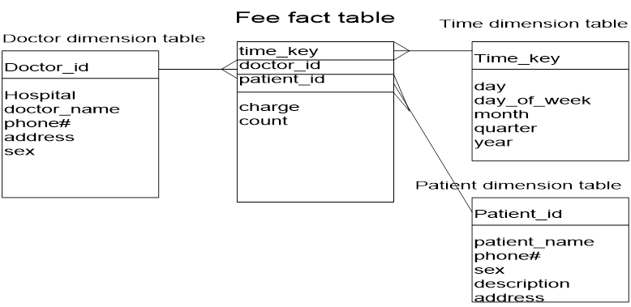

Slide 89
Data warehouse design and usage

Slide 90
Data Warehouse Usage

Slide 91
Introduction
Data warehouses and data marts are used in a wide range of applications.
Business executives use the data in data warehouses and data marts to perform data analysis and make strategic decisions.
Data warehouses are used extensively in banking and financial services, consumer goods and retail distribution sectors, and controlled manufacturing such as demand-based production.

Slide 92
Initially, the data warehouse is mainly used for generating reports and answering predefined queries.
Progressively, it is used to analyze summarized and detailed data, where the results are presented in the form of reports and charts.
Later, the data warehouse is used for strategic purposes, performing multidimensional analysis and sophisticated slice-and-dice operations.
Finally, the data warehouse may be employed for knowledge discovery and strategic decision making using data mining tools.

Slide 93
A data warehouse is a system that aggregates data from multiple sources into a single, central, consistent data store to support data mining, artificial intelligence (AI), and machine learning—which, ultimately, can enhance sophisticated analytics and business intelligence.
A data mart (as noted above) is a focused version of a data warehouse that contains a smaller subset of data important to and needed by a single team or a select group of users within an organization.

Slide 94
Why do we need Data Mart?
Data Mart helps to enhance user’s response time due to reduction in volume of data
It provides easy access to frequently requested data.
Data is partitioned and allows very granular access control privileges.
Data can be segmented and stored on different hardware/software platforms.
Compared to Data Warehouse, a datamart is agile. In case of change in model, datamart can be built quicker due to a smaller size.

Slide 95
Types of data marts
Dependent: Dependent data marts are created by drawing data directly from operational, external or both sources.
Independent: Independent data mart is created without the use of a central data warehouse.
Hybrid: This type of data marts can take data from data warehouses or operational systems.

Slide 96
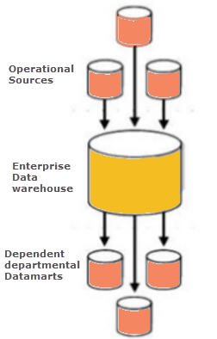
Dependent Data Mart

Slide 97
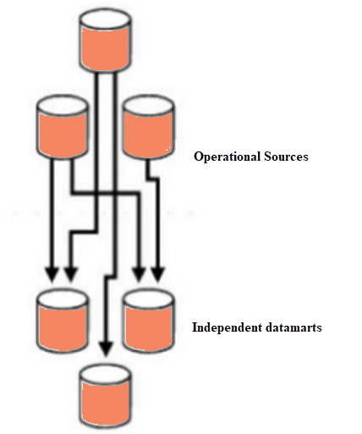
Independent Data Mart

Slide 98
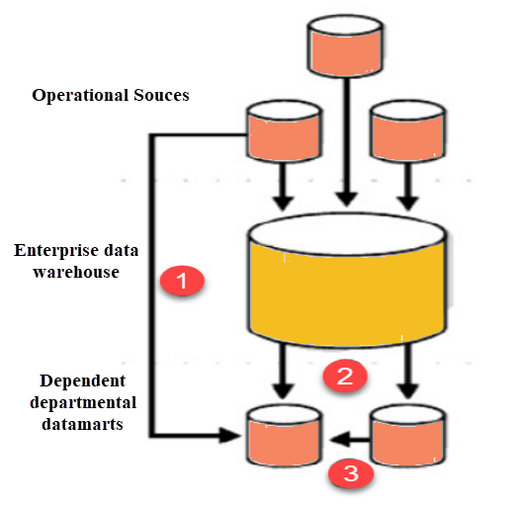
Hybrid Data Mart

Slide 99
Steps in Implementing a Datamart

Slide 100
Designing: Since the time business users request a data mart, the designing phase involves requirements gathering, creating appropriate data from respective data sources, creating the logical and physical data structures and ER diagrams.
Constructing: The team will design all tables, views, indexes, etc., in the data mart system.
Populating: Data will be extracted, transformed and loaded into data mart along with metadata.

Slide 101
Accessing: Data Mart data is available to be accessed by the end-users. They can query the data for their analysis and reports.
Managing: This involves various managerial tasks such as user access controls, data mart performance fine-tuning, maintaining existing data marts and creating data mart recovery scenarios in case the system fails.

Slide 102
Structure of a data mart
A data mart is a subject-oriented relational database that stores transactional data in rows and columns, which makes it easy to access, organize, and understand.
As it contains historical data, this structure makes it easier for an analyst to determine data trends.
Typical data fields include numerical order, time value, and references to one or more objects.

Slide 103
Companies organize data marts in a multidimensional schema as a blueprint to address the needs of the people using the databases for analytical tasks. The three main types of schema are star, snowflake, and vault.

Slide 104
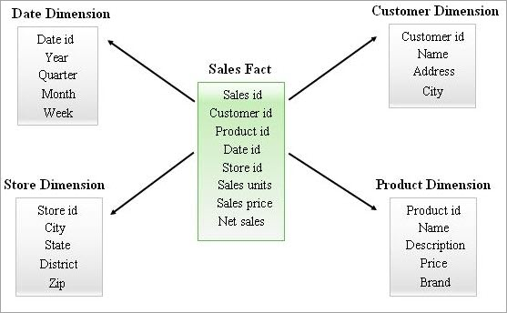
Structure Of A Data Mart

Slide 105
Star schema is a logical formation of tables in a multidimensional database that resembles a star shape.
A snowflake schema is a logical extension of a star schema, building out the blueprint with additional dimension tables.
Data vault is a modern database modeling technique that enables IT professionals to design agile enterprise data warehouses.

Slide 106
Benefits of a data mart
Cost-efficiency - extract, transform, and load (ETL)
Simplified data access - hold a small subset of data, so users can quickly retrieve the data
Quicker access to insights
Simpler data maintenance - Data marts focus on a single line, housing under 100GB, which leads to less clutter and easier maintenance.
Easier and faster implementation

Slide 107
Drawbacks Of Data Mart
Unwanted data marts that have been created are tough to maintain.
Data marts are meant for small business needs. Increasing the size of data marts will decrease its performance.
If you are creating more number of data marts then the management should properly take care of their versioning, security, and performance.
Data marts may contain historical (or) summarized (or) detailed data. However, updates to DW data and data mart data may not happen at the same time due to data inconsistency issues.

Slide 108
Summary
Define Data Mart : A Data Mart is defined as a subset of Data Warehouse that is focused on a single functional area of an organization.
Data Mart helps to enhance user’s response time due to a reduction in the volume of data.
Three types of data mart are 1) Dependent 2) Independent 3) Hybrid
Important implementation steps of Data Mart are 1) Designing 2) Constructing 3 Populating 4) Accessing and 5)Managing
The implementation cycle of a Data Mart should be measured in short periods of time, i.e., in weeks instead of months or years.
Data mart is cost-effective alternatives to a data warehouse, which can take high costs to build.
Data Mart cannot provide company-wide data analysis as data set is limited.

Slide 109
Benefits of Data Warehouses
The primary benefit of a data warehouse is storing and analyzing large amounts of variant data and extract value from them while keeping historical data for record-keeping.
Bill Inmon, the father of data warehousing, gave four unique characteristics of data warehouses, such as:
Being subject-oriented to focus on a particular area;
Ability to integrate different data types from various sources;
Non-volatile (stable); and
Time-variant, which analyzes changes over time.

Slide 110
How Do Data Warehouses Work?
A data warehouse operates as a central repository where information arrives from various sources. The data that flows in may be structured, semi-structured, or unstructured and may come from internal applications, customer-facing applications, and external systems.
Once in the data warehouse, the data is ingested, transformed, and processed to allow users to access the processed data in decision-making. By merging large quantities of information in the data warehouse, an organization can form a more holistic analysis to ensure that it already considered all the available information before making a decision.

Slide 111
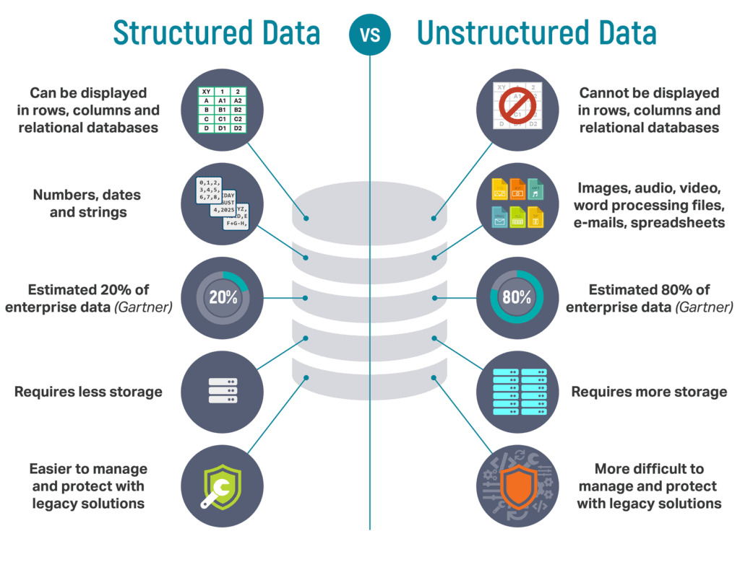

Slide 112
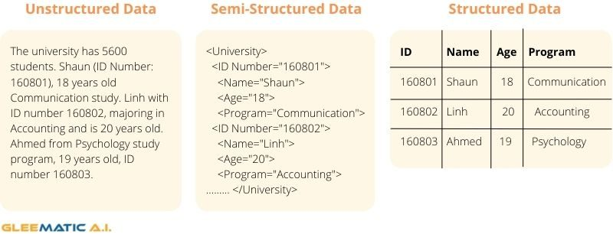

Slide 113
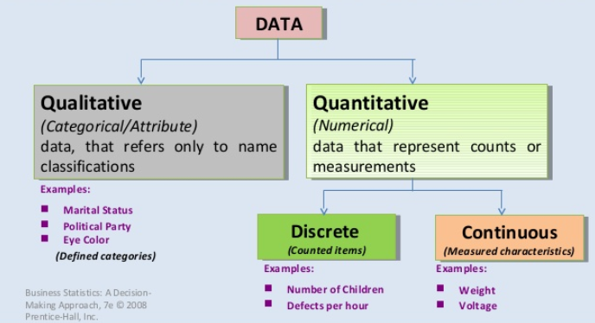

Slide 114
Data Warehouse Applications
There are three kinds of data warehouse applications:
information processing,
analytical processing, and
data mining.

Slide 115
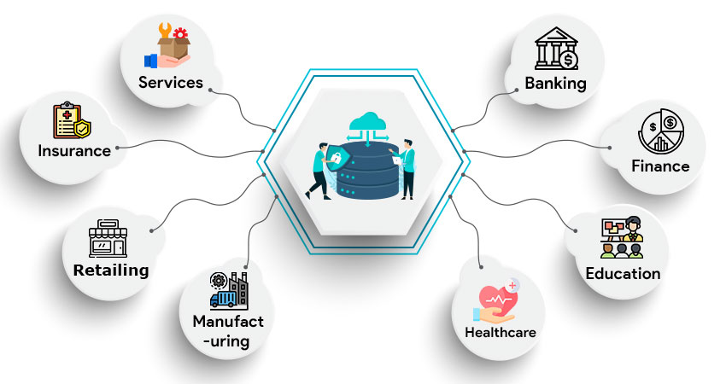

Slide 116
Banking
With the perfect Data Warehousing solution, bankers can manage all their available resources more effectively. They can better analyze their consumer data, government regulations, and market trends to facilitate better decision-making.
Finance
The application of data warehousing in the financial industry is the same as in the banking sector. The right solution helps the financing industry analyze customer expenses that enable them to outline better strategies to maximize profits at both ends.

Slide 117
Education
The educational sector requires data warehousing to have a comprehensive view of their students’ and faculty data. It provides educational institutions access to real-time data feeds to make valued and informed decisions.
Healthcare
Another critical use of data warehouses is in the Healthcare sector. All the clinical, financial, and employee data are stored in the warehouse, and analysis is run to derive valuable insights to strategize resources in the best way possible.

Slide 118
Data Warehouse Applications
Information processing
supports querying, basic statistical analysis, and reporting using crosstabs, tables, charts and graphs
Analytical processing
It generally operates on historic data in both summarized and detailed forms.
supports basic OLAP operations, slice-dice, drilling, pivoting.
The major strength of online analytical processing over information processing is the multidimensional data analysis of data warehouse data.
Data mining
knowledge discovery from hidden patterns
supports associations, constructing analytical models, performing classification and prediction, and presenting the mining results using visualization tools

Slide 119
Application
..\Downloads\15-Data warehousing_lec.pdf

Slide 120
“How does data mining relate to information processing and online analytical processing? ”
Information processing, based on queries, can find useful information. However, answers to such queries reflect the information directly stored in databases or computable by aggregate functions.
It do not reflect hidden patterns or regularities buried in the database.
Therefore, information processing is not data mining.

Slide 121
“Do OLAP systems perform data mining? Are OLAP systems actually data mining systems?”
The functionalities of OLAP and data mining can be viewed as disjoint.
OLAP is a data summarization/aggregation tool that helps simplify data analysis.
Data mining allows the automated discovery of implicit patterns and interesting knowledge hidden in large amounts of data.
OLAP functions are essentially for user-directed data summarization and comparison.
Data mining covers a much broader spectrum than simple OLAP operations, because it performs not only data summarization and comparison but also association, classification, prediction, clustering, time-series analysis, and other data analysis tasks.

Slide 122
Data mining is not confined to the analysis of data stored in data warehouses.
It may also analyze transactional, spatial, textual, and multimedia data that are difficult to model with current multidimensional database technology.

Slide 123
From Online Analytical Processing to Multidimensional Data Mining
Multidimensional data mining (also known as exploratory multidimensional data mining, online analytical mining, or OLAM) integrates OLAP with data mining to uncover knowledge in multidimensional databases.
Among the many different paradigms and architectures of data mining systems, multidimensional data mining is particularly important for the following reasons:

Slide 124
From Online Analytical Processing to Multidimensional Data Mining
High quality of data in data warehouses:
Most data mining tools need to work on integrated, consistent, and cleaned data, which requires costly data cleaning, data integration, and data transformation as preprocessing steps.
A data warehouse constructed by such preprocessing serves as a valuable source of high-quality data for OLAP as well as for data mining.

Slide 125
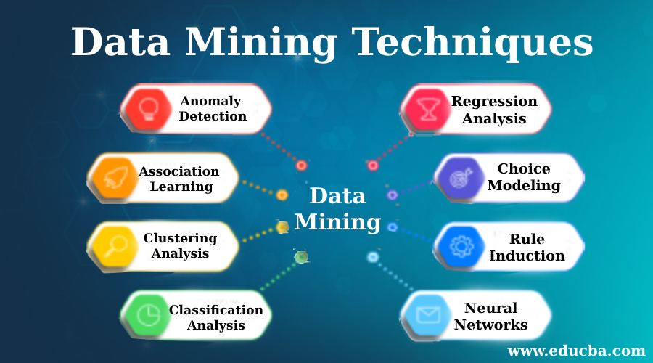
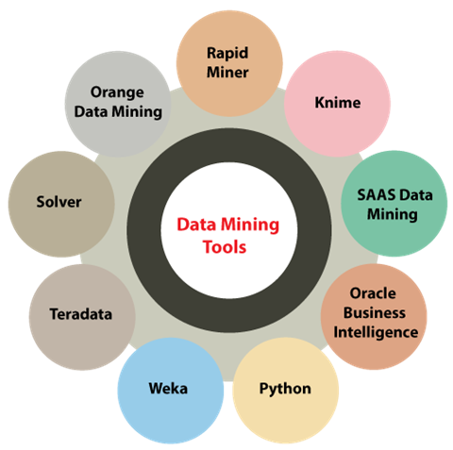

Slide 126
From Online Analytical Processing to Multidimensional Data Mining
Available information processing infrastructure surrounding data warehouses:
Comprehensive information processing and data analysis infrastructures have been or will be systematically constructed surrounding data warehouses, which include accessing, integration, consolidation, and transformation of multiple heterogeneous databases, ODBC/OLEDB connections, Web accessing and service facilities, and reporting and OLAP analysis tools.
It is prudent to make the best use of the available infrastructures rather than constructing everything from scratch.

Slide 127
From Online Analytical Processing to Multidimensional Data Mining
OLAP-based exploration of multidimensional data:
Effective data mining needs exploratory data analysis. A user will often want to traverse through a database, select portions of relevant data, analyze them at different granularities, and present knowledge/results in different forms.
Online selection of data mining functions:
Users may not always know the specific kinds of knowledge they want to mine. By integrating OLAP with various data mining functions, multidimensional data mining provides users with the flexibility to select desired data mining functions and swap data mining tasks dynamically.

Slide 128
Data warehouse implementation

Slide 129
Data Warehouse Implementation
Data warehouses contain huge volumes of data.
OLAP servers demand that decision support queries be answered in the order of seconds.
Therefore, it is crucial for data warehouse systems to support highly efficient cube computation techniques, access methods, and query processing techniques.

Slide 130
Efficient Data Cube Computation
One approach to cube computation extends SQL so as to include a compute cube operator.
The compute cube operator computes aggregates over all subsets of the dimensions specified in the operation.
This can require excessive storage space, especially for large numbers of dimensions.

Slide 131

EXAMPLE

Slide 132
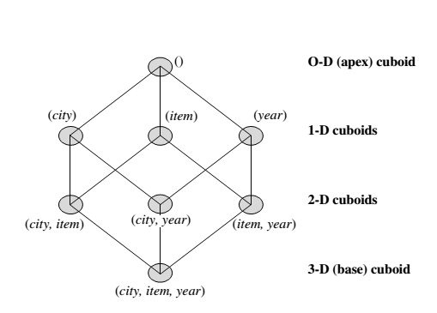
EXAMPLE
If we start at the apex cuboid and explore downward in the lattice, this is equivalent to drilling down within the data cube. If we start at the base cuboid and explore upward,
this is akin to rolling up.

Slide 133
An SQL query containing no group-by (e.g., “compute the sum of total sales”) is a zero dimensional operation.
An SQL query containing one group-by (e.g., “compute the sum of sales, group-by city ”) is a one-dimensional operation.
A cube operator on n dimensions is equivalent to a collection of group-by statements, one for each subset of the n dimensions.

Slide 134
Similar to the SQL syntax, the data cube can be defined as:
define cube sales_cube [city, item, year]: sum(sales_in_dollars)
A statement such as
compute cube sales_cube
would explicitly instruct the system to compute the sales aggregate cuboids for all eight subsets of the set {city, item, year }, including the empty subset.

Slide 135
Transform it into a SQL-like language (with a new operator cube by, introduced by Gray et al.’96)
SELECT item, city, year, SUM (amount)
FROM SALES
CUBE BY item, city, year

Slide 136

“How many cuboids are there in an n-dimensional data cube ???”

Slide 137


“How many cuboids are there in an n-dimensional data cube ???”

Slide 138
By now, you probably realize that it is unrealistic to pre-compute and materialize all of the cuboids that can possibly be generated for a data cube.
If there are many cuboids, and these cuboids are large in size.
A more reasonable option is partial materialization; that is, to materialize only some of the possible cuboids that can be generated.

Slide 139
What is Data Cube?
When data is grouped or combined in multidimensional matrices called Data Cubes. The data cube method has a few alternative names or a few variants, such as "Multidimensional databases," "materialized views," and "OLAP (On-Line Analytical Processing)."

Slide 140
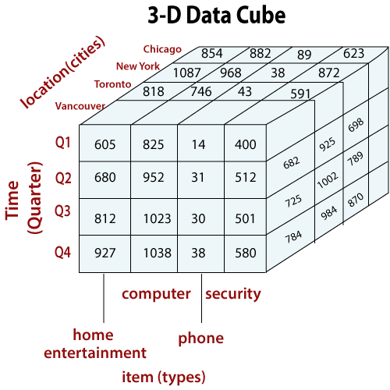
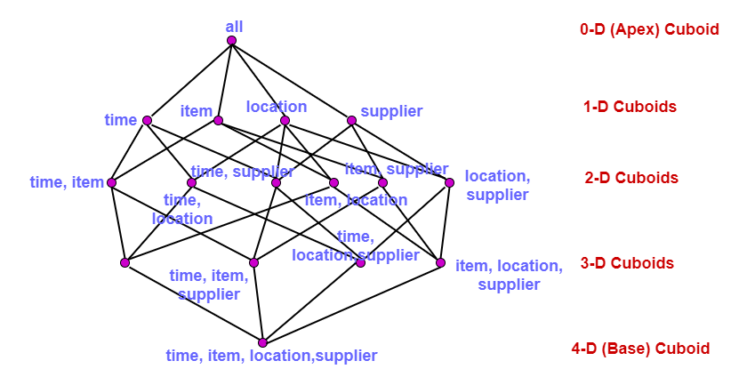

Slide 141
Partial Materialization: Selected Computation of Cuboids
There are three choices for data cube materialization given a base cuboid:
No materialization: Do not pre-compute any of the “non-base” cuboids. This leads to computing expensive multidimensional aggregates on-the-fly, which can be extremely slow.
Full materialization: Pre-compute all of the cuboids. It is referred to as the full cube. It requires huge amounts of memory space in order to store all of the pre-computed cuboids.

Slide 142
Partial Materialization: Selected Computation of Cuboids
Partial materialization:
We may compute a subset of the cube, which contains only those cells that satisfy some user-specified criterion. It is also referred to as sub-cube.

Slide 143
Indexing OLAP Data: Bitmap Index and Join Index
To facilitate efficient data accessing, most data warehouse systems support index structures and materialized views (using cuboids).
Bitmap indexes have traditionally been considered to work well for data such as gender, which has a small number of distinct values, for example male and female, but many occurrences of those values.

Slide 144
Bitmap Index
The bitmap indexing method is popular in OLAP because it allows quick searching in data cubes.
If a given attribute’s domain consists of n values, then n bits are needed for each entry in the bitmap index (i.e., there are n bit vectors).
If the attribute has the value v for a given row in the data table, then the bit representing that value is set to 1 in the corresponding row of the bitmap index. All other bits for that row are set to 0.

Slide 145
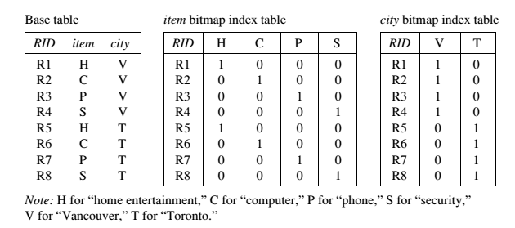
Bitmap Index

Slide 146
Bitmap Index Facts
Bitmap indexing is advantageous compared to hash and tree indices.
It is especially useful for low-cardinality domains.
Bitmap indexing leads to significant reductions in space and input/output (I/O) since a string of characters can be represented by a single bit.
For higher-cardinality domains, the method can be adapted using compression techniques.

Slide 147
join indexing
Traditional indexing maps the value in a given column to a list of rows having that value.
Join indexing registers the joinable rows of two relations from a relational database.
Join indexing is especially useful for maintaining the relationship between a foreign key and its matching primary keys, from the joinable relation.
Join index: JI(R-id, S-id) where R (R-id, …)  S (S-id, …)

Slide 148
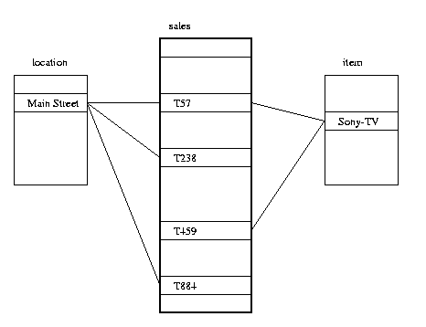
In data warehouses, join index relates the values of the dimensions of a star schema to rows in the fact table.
E.g. fact table: Sales and two dimensions city and product.
Join indices can span multiple dimensions.

Slide 149
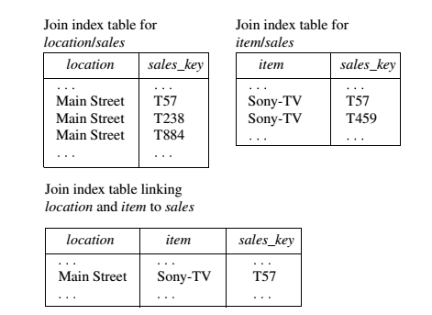
Example

Slide 150
Efficient Processing of OLAP Queries
The purpose of materializing cuboids and constructing OLAP index structures is to speed up query processing in data cubes. Given materialized views, query processing should proceed as follows:
Determine which operations should be performed on the available cuboids.
Determine to which materialized cuboid(s) the relevant operatiozns should be applied.

Slide 151
example
Suppose that we define a data cube for AllElectronics of the form “sales cube [time, item, location]: sum(sales in dollars).”
The dimension hierarchies used are
“day < month < quarter < year ” for time ;
“item name < brand < type ” for item;
“street < city < province or state < country ” for location.

Slide 152
cuboid 1: {year, item_name, city}
cuboid 2: {year, brand, country }
cuboid 3: {year, brand, province_or_state}
cuboid 4: {item_name, province_or_state }, where year = 2010
“Which of these four cuboids should be selected to process the query?”

Slide 153
result
Finer-granularity data cannot be generated from coarser-granularity data.
Therefore, cuboid 2 cannot be used because country is a more general concept than province or state.
Cuboids 1, 3, and 4 can be used to process the query

